Slide 1



Python vs. JavaScript/Java
Do developers who primarily use Python earn significantly different salaries than those who primarily use JavaScript and or Java?
By: Timothy Myers, Harden Gage, and Anthony Stribling
Capstone Project - SDT 100 01

Slide 2

Why This Matters?
Tech firms need competitive and fair pay to attract and keep developers.
Python, JavaScript, and Java are three of the most widely used programming languages.
They are used in different roles:
  Python: data science, automation, backend.
  JavaScript: front end and web.
  Java: enterprise systems, Android, large backend systems.
If salaries differ by language and experience, it affects:
  Hiring budgets
  Training and upskilling decisions
  Long term talent strategy
Capstone Project - SDT 100 01

Slide 3

Cleaned sample for this project:
United States only
Employed respondents only
Salary between $30,000 and $500,000
1–30 years of coding experience
Data Overview
Final analysis groups:
Python-focused developers (no JavaScript or Java in the same row)
JavaScript/Java developers (combined comparison group)
Cleaned counts:
  Python: 558 developers
  JavaScript/Java: 998 developers
Key variables:
Annual salary (ConvertedCompYearly)
Years of coding (YearsCode or YearsCodePro)
Languages used (LanguageHaveWorkedWith)
Source: Stack Overflow Annual Developer Survey 2025.
Raw data: about 49,000 developer responses and 170 variables.
Capstone Project - SDT 100 01

Slide 4
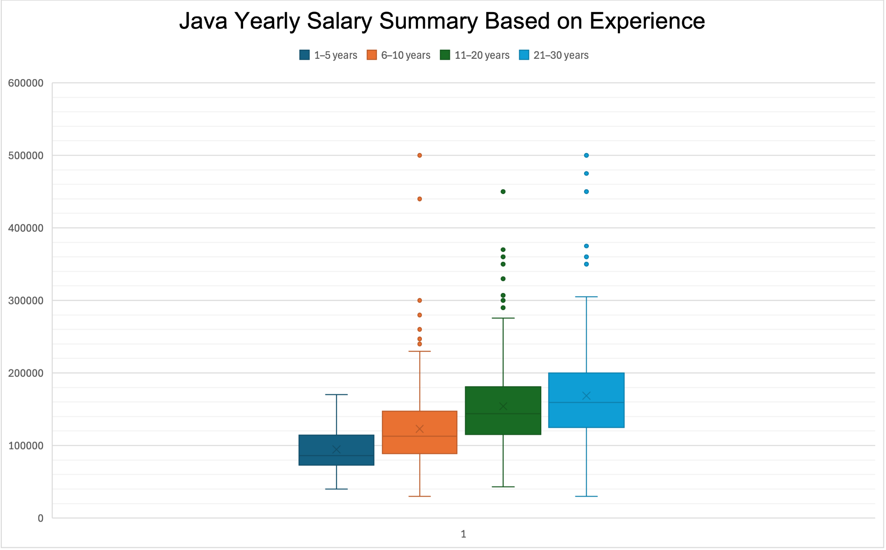
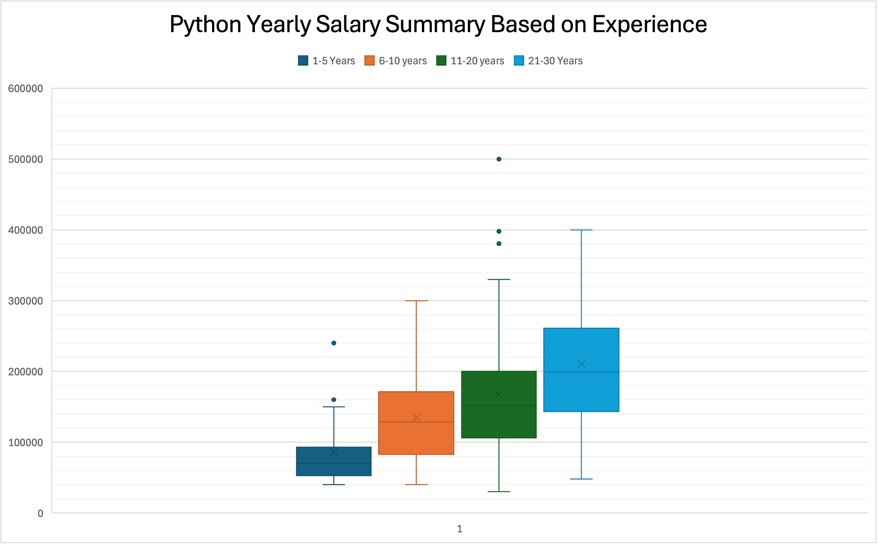
Salary by Language and Experience
Capstone Project - SDT 100 01
Overall Mean Salary: $150,340.13
Overall Median Salary: $140,000
Overall Mean Salary: $162,279.16
Overall Median Salary: $150,000

Slide 5

Experience Group | P-Value | Significant
1-5 Years | 0.2003 | No
6-10 Years | 0.5987 | No
11-20 Years | 0.0135 | Yes
21-30 Years | 0.000051 | Yes
Statistical Results
Used Welch’s t-test (two sample, unequal variances) in Excel.
Compared Python salary vs JavaScript/Java salary within each experience group.
  At 1–5 and 6–10 years, p-values are greater than 0.05 → no significant difference.
  At 11–20 years, Python developers earn about 9 percent more, p ≈ 0.0135 → significant.
  At 21–30 years, Python developers earn about 17 percent more, p ≈ 0.000051 → very strong evidence.
Overall, Python developers earn about $11,700 more on average, and the overall p-value is significant.
Capstone Project - SDT 100 01

Slide 6


Business
Recommendations:
What Should Companies Do with This?
For Companies:
At 1–10 years, pay ranges for Python, JavaScript, and Java can be similar.
For 11–30 years, plan higher salary bands for experienced Python roles, especially in:
  Data analytics
  Machine learning
  Automation and backend systems
Invest in Python training for developers in data and backend teams.
Capstone Project - SDT 100 01

Slide 7

Limitations and Caution
Limits of Our Analysis:
Self reported survey data means some salaries or experience values may be off.
This is a single survey of a one year time frame and may not represent every developer or future years.
Did not control for:
  Location (State/City Wage Differences)
  Company size
  Industry
  Job title
Results show patterns in this dataset, not a guarantee for every firm.
Capstone Project - SDT 100 01

Slide 8

Q & A

Slide 9
Thank You!

